Slide 1
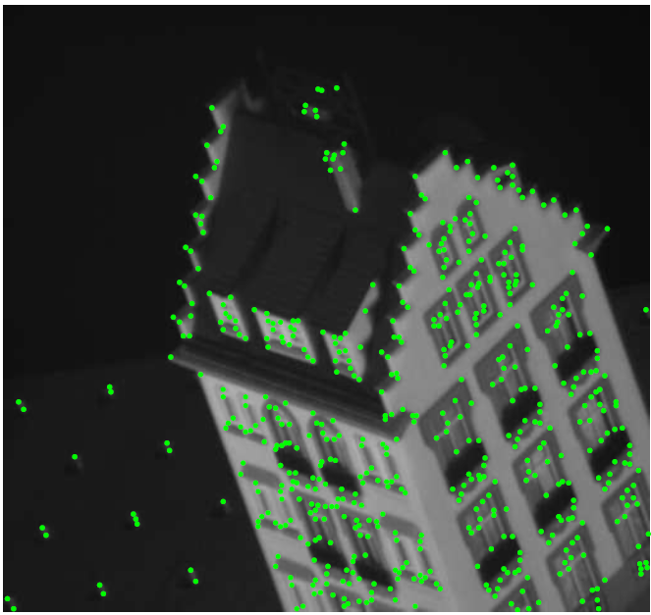
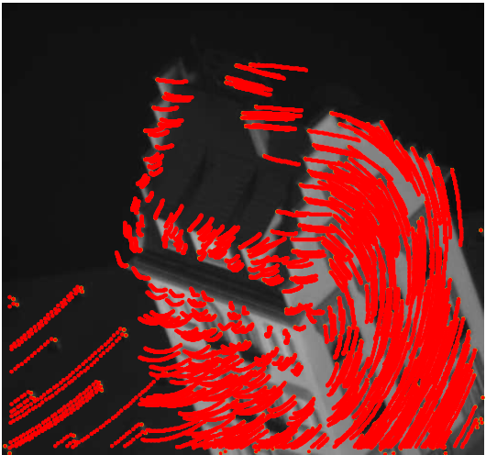
Feature Tracking and Optical Flow
Computer Vision
Jia-Bin Huang, Virginia Tech
Many slides from D. Hoiem

Slide 2
Administrative Stuffs
HW 1 due 11:55 PM Sept 17
Submission through Canvas
HW 1 Competition: Edge Detection
Submission link

Slide 3
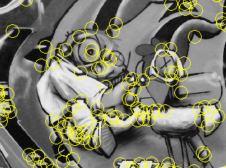
Things to remember
Keypoint detection: repeatable and distinctive
Corners, blobs, stable regions
Harris, DoG
Descriptors: robust and selective
spatial histograms of orientation
SIFT

Slide 4
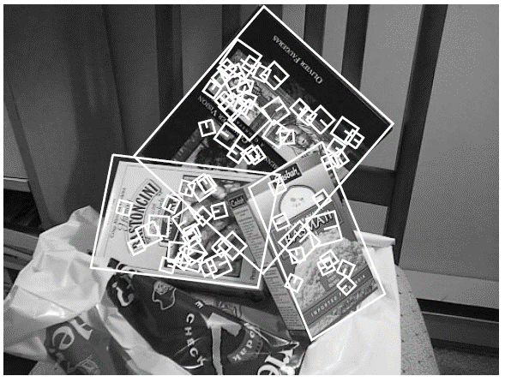
Local Descriptors: SIFT Descriptor
Histogram of oriented gradients
Captures important texture information
Robust to small translations / affine deformations
[Lowe, ICCV 1999]
K. Grauman, B. Leibe

Slide 5
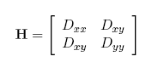
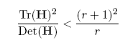
Details of Lowe’s SIFT algorithm
Run DoG detector
Find maxima in location/scale space
Remove edge points
Find all major orientations
Bin orientations into 36 bin histogram
Weight by gradient magnitude
Weight by distance to center (Gaussian-weighted mean)
Return orientations within 0.8 of peak
Use parabola for better orientation fit
For each (x,y,scale,orientation), create descriptor:
Sample 16x16 gradient mag. and rel. orientation
Bin 4x4 samples into 4x4 histograms
Threshold values to max of 0.2, divide by L2 norm
Final descriptor: 4x4x8 normalized histograms
Lowe IJCV 2004

Slide 6

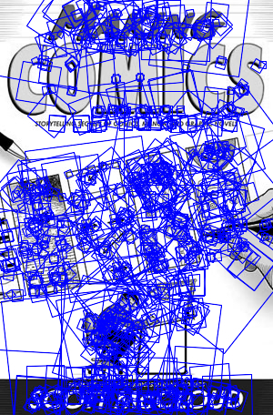
SIFT Example
sift
868 SIFT features

Slide 7
Feature matching
Given a feature in I₁, how to find the best match in I₂?
Define distance function that compares two descriptors
Test all the features in I₂, find the one with min distance

Slide 8
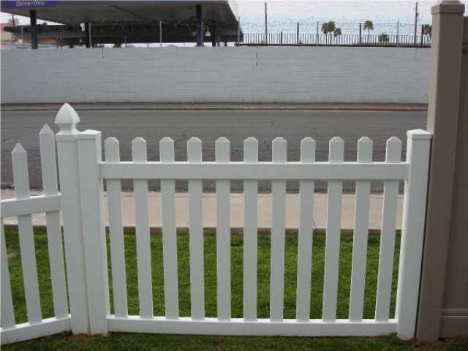
Feature distance
How to define the difference between two features f₁, f₂?
Simple approach: L₂ distance, ||f₁ - f₂ ||
can give good scores to ambiguous (incorrect) matches
f₁
f₂
I₁
I₂

Slide 9
Feature distance
How to define the difference between two features f₁, f₂?
Better approach: ratio distance = ||f₁ - f₂ || / || f₁ - f₂’ ||
f₂ is best SSD match to f₁ in I₂
f₂’ is 2nd best SSD match to f₁ in I₂
gives large values for ambiguous matches
f₁
f₂'
f₂
I₁
I₂

Slide 10
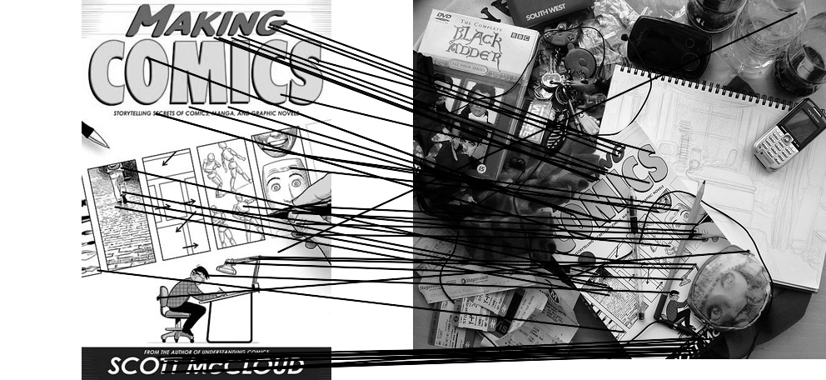


Feature matching example
51 matches

Slide 11
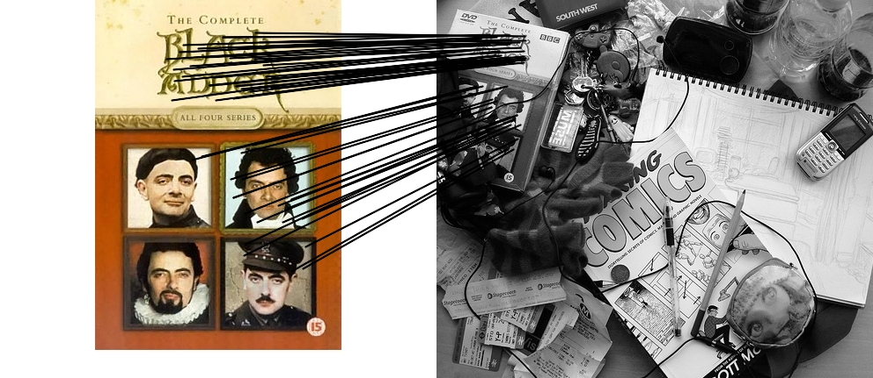
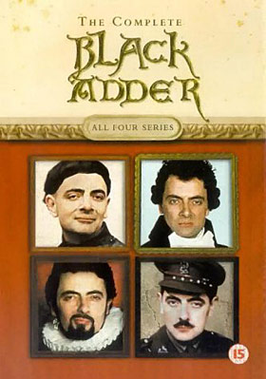
Feature matching example
58 matches

Slide 12
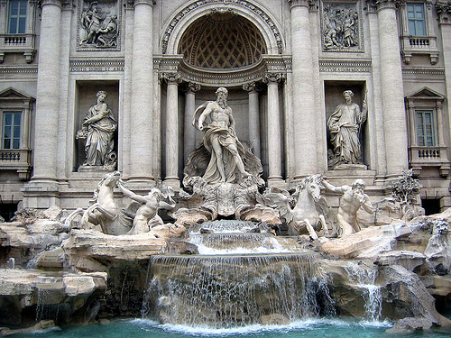
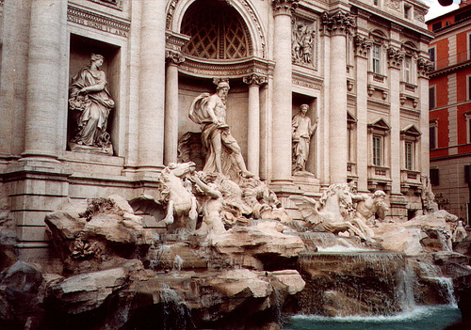
Evaluating the results
How can we measure the performance of a feature matcher?
50
75
200
feature distance

Slide 13
True/false positives
How can we measure the performance of a feature matcher?
The distance threshold affects performance
True positives = # of detected matches that are correct
Suppose we want to maximize these—how to choose threshold?
False positives = # of detected matches that are incorrect
Suppose we want to minimize these—how to choose threshold?
50
true match
75
200
false match
feature distance

Slide 14
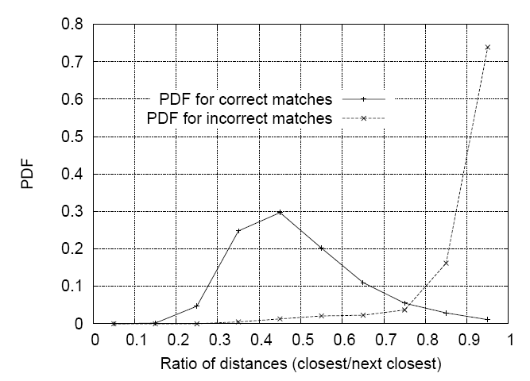
Matching SIFT Descriptors
Nearest neighbor (Euclidean distance)
Threshold ratio of nearest to 2nd nearest descriptor
Lowe IJCV 2004

Slide 15
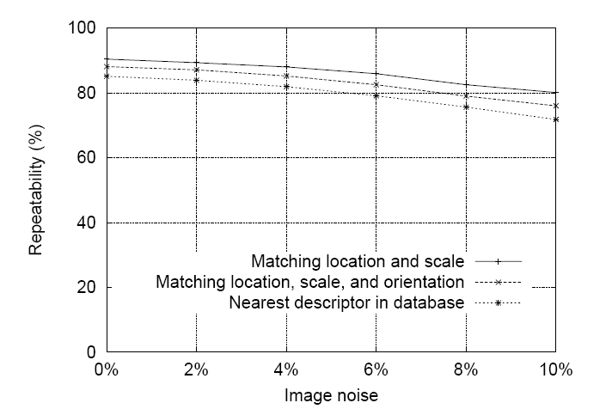
SIFT Repeatability
Lowe IJCV 2004

Slide 16
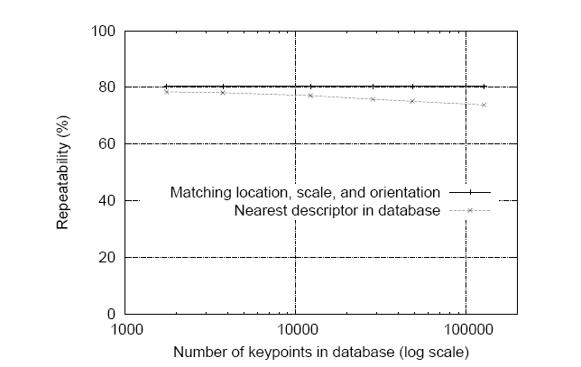
SIFT Repeatability
Lowe IJCV 2004

Slide 17
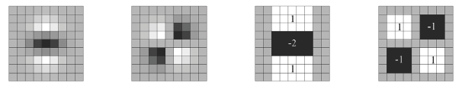
Local Descriptors: SURF
Fast approximation of SIFT idea
Efficient computation by 2D box filters & integral images ⇒ 6 times faster than SIFT
Equivalent quality for object identification
GPU implementation available
Feature extraction @ 200Hz (detector + descriptor, 640×480 img)
http://www.vision.ee.ethz.ch/~surf
Many other efficient descriptors are also available
[Bay, ECCV’06], [Cornelis, CVGPU’08]

Slide 18
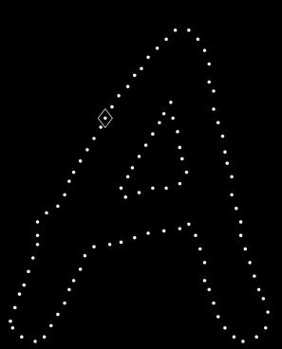
Local Descriptors: Shape Context
Count the number of points inside each bin, e.g.:
Count = 4
...
Count = 10
Log-polar binning: more precision for nearby points, more flexibility for farther points.
Belongie & Malik, ICCV 2001
K. Grauman, B. Leibe

Slide 19
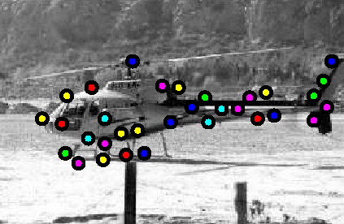
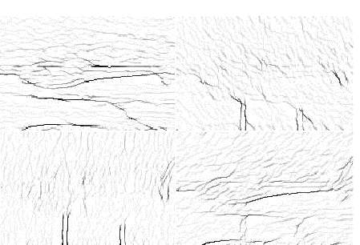
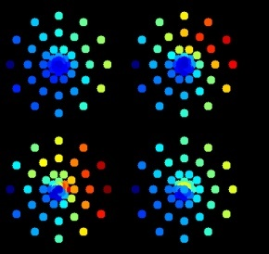
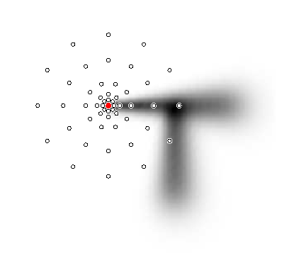
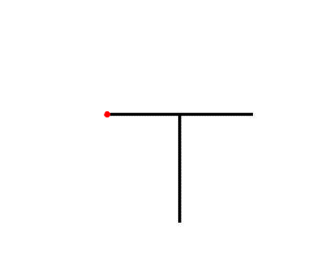
Local Descriptors: Geometric Blur
Compute edges at four orientations
Extract a patch
in each channel
~
Apply spatially varying
blur and sub-sample
Example descriptor
(Idealized signal)
Berg & Malik, CVPR 2001
K. Grauman, B. Leibe

Slide 20
Choosing a detector
What do you want it for?
Precise localization in x-y: Harris
Good localization in scale: Difference of Gaussian
Flexible region shape: MSER
Best choice often application dependent
Harris-/Hessian-Laplace/DoG work well for many natural categories
MSER works well for buildings and printed things
Why choose?
Get more points with more detectors
There have been extensive evaluations/comparisons
[Mikolajczyk et al., IJCV’05, PAMI’05]
All detectors/descriptors shown here work well

Slide 21
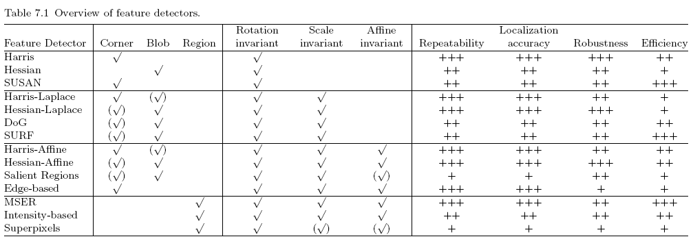
Comparison of Keypoint Detectors
Tuytelaars Mikolajczyk 2008

Slide 22
Choosing a descriptor
Again, need not stick to one
For object instance recognition or stitching, SIFT or variant is a good choice

Slide 23
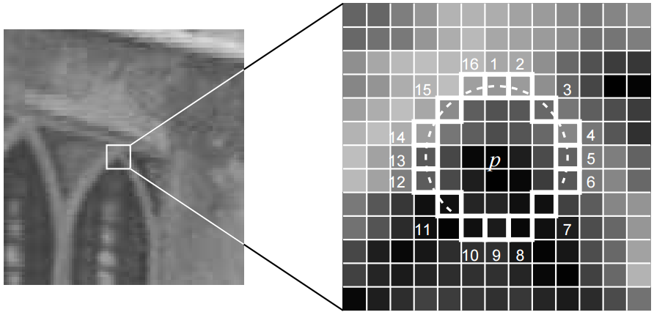
Recent advances in interest points
Features from Accelerated Segment Test, ECCV 06
Binary feature descriptors
BRIEF: Binary Robust Independent Elementary Features, ECCV 10
ORB (Oriented FAST and Rotated BRIEF), CVPR 11
BRISK: Binary robust invariant scalable keypoints, ICCV 11
Freak: Fast retina keypoint, CVPR 12
LIFT: Learned Invariant Feature Transform, ECCV 16

Slide 24
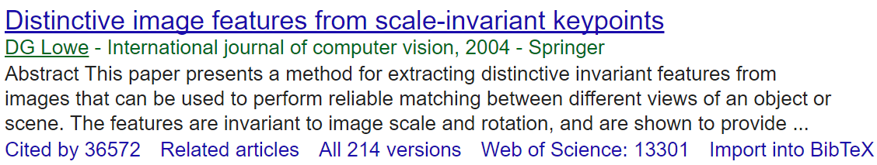
Previous class
Interest point/keypoint/feature detectors
Harris: detects corners
DoG: detects peaks/troughs
Interest point/keypoint/feature descriptors
SIFT (do read the paper)
Feature matching
Ratio distance = ||f₁ - f₂ || / || f₁ - f₂’ ||
Remove 90% false matches, 5% of true matches in Lowe’s study
f₂
f₁
f₂'
I₁
I₂

Slide 25
This class: Recovering motion
Feature tracking
Extract visual features (corners, textured areas) and “track” them over multiple frames
Optical flow
Recover image motion at each pixel from spatio-temporal image brightness variations
Two problems, one registration method
B. Lucas and T. Kanade. An iterative image registration technique with an application to
stereo vision. In Proceedings of the International Joint Conference on Artificial Intelligence, 1981.

Slide 26
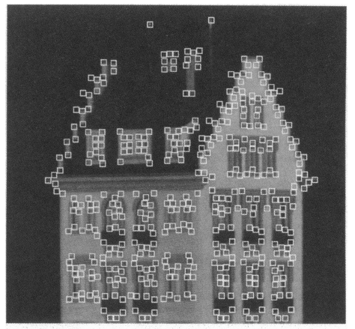
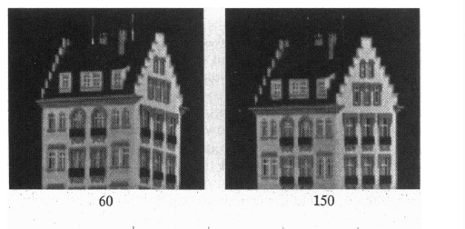
Feature tracking
Many problems, such as structure from motion require matching points
If motion is small, tracking is an easy way to get them

Slide 27
Feature tracking - Challenges
Figure out which features can be tracked
Efficiently track across frames
Some points may change appearance over time (e.g., due to rotation, moving into shadows, etc.)
Drift: small errors can accumulate as appearance model is updated
Points may appear or disappear: need to be able to add/delete tracked points

Slide 28
Feature tracking
I(x,y,t)
I(x,y,t+1)
Given two subsequent frames, estimate the point translation
Key assumptions of Lucas-Kanade Tracker
Brightness constancy: projection of the same point looks the same in every frame
Small motion: points do not move very far
Spatial coherence: points move like their neighbors

Slide 29
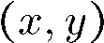
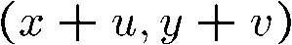
The brightness constancy constraint
I(x,y,t)
I(x,y,t+1)
Brightness Constancy Equation:
Take Taylor expansion of I(x+u, y+v, t+1) at (x,y,t) to linearize the right side:
Image derivative along x
Difference over frames
So:
Notes:
Brightness constancy equation is equivalent to minimizing the squared error of I(t) and I(t+1)

Slide 30
The brightness constancy constraint
Can we use this equation to recover image motion (u,v) at each pixel?
How many equations and unknowns per pixel?
One equation (this is a scalar equation!), two unknowns (u,v)
The component of the motion perpendicular to the gradient (i.e., parallel to the edge) cannot be measured
If (u, v) satisfies the equation, so does (u+u’, v+v’ ) if
gradient
(u,v)
(u’,v’)
(u+u’,v+v’)
edge
Notes:
A: u and v are unknown, 1 equation

Slide 31
The aperture problem
Actual motion

Slide 32
The aperture problem
Perceived motion

Slide 33

The barber pole illusion
http://en.wikipedia.org/wiki/Barberpole_illusion

Slide 34


The barber pole illusion
http://en.wikipedia.org/wiki/Barberpole_illusion

Slide 35
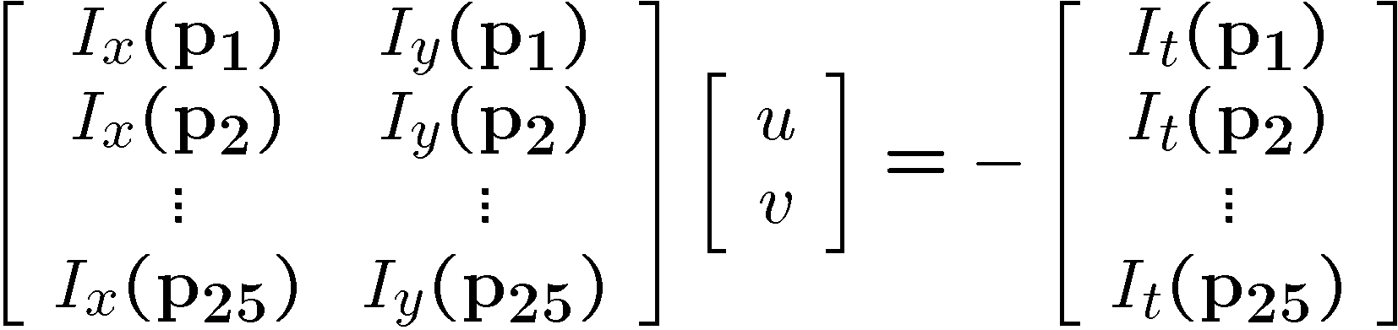
Solving the ambiguity…
B. Lucas and T. Kanade. An iterative image registration technique with an application to stereo vision.
In Proceedings of the International Joint Conference on Artificial Intelligence, pp. 674–679, 1981.
How to get more equations for a pixel?
Spatial coherence constraint
Assume the pixel’s neighbors have the same (u,v)
If we use a 5x5 window, that gives us 25 equations per pixel

Slide 36




Solving the ambiguity…
Least squares problem:

Slide 37
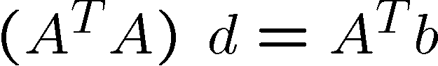
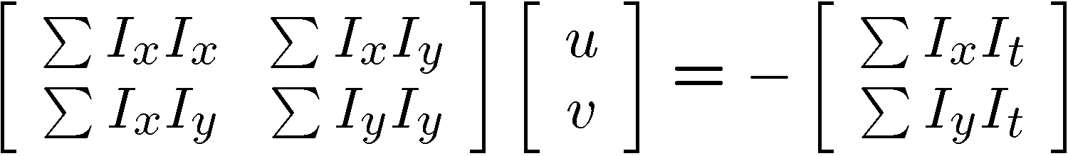
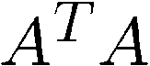
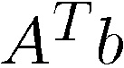
Matching patches across images
Overconstrained linear system
Least squares solution for d given by
The summations are over all pixels in the K x K window

Slide 38
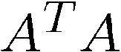
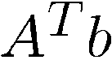
Conditions for solvability
Optimal (u, v) satisfies Lucas-Kanade equation
When is this solvable? I.e., what are good points to track?
A^{T}A should be invertible
A^{T}A should not be too small due to noise
eigenvalues λ₁ and λ ₂ of A^{T}A should not be too small
A^{T}A should be well-conditioned
λ ₁/ λ ₂ should not be too large (λ ₁ = larger eigenvalue)
Does this remind you of anything?
Criteria for Harris corner detector

Slide 39
M = A^{T}A is the second moment matrix !
(Harris corner detector…)
Eigenvectors and eigenvalues of A^{T}A relate to edge direction and magnitude
The eigenvector associated with the larger eigenvalue points in the direction of fastest intensity change
The other eigenvector is orthogonal to it
Notes:
Suppose M = vv^T . What are the eigenvectors and eigenvalues? Start by considering Mv

Slide 40
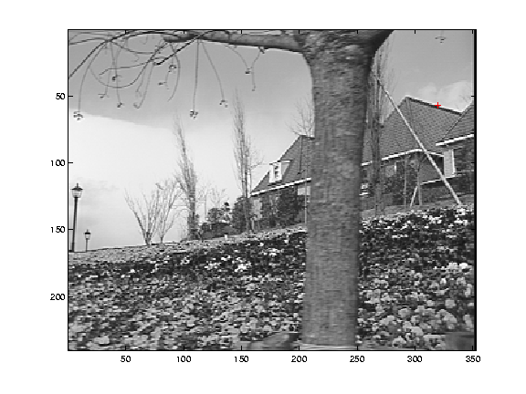
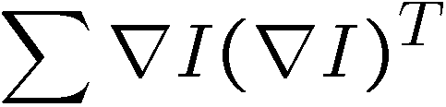
Low-texture region
gradients have small magnitude
small λ₁, small λ₂

Slide 41
Edge
gradients very large or very small
large λ₁, small λ₂

Slide 42
High-texture region
gradients are different, large magnitudes
large λ₁, large λ₂

Slide 43
The aperture problem resolved
Actual motion

Slide 44
The aperture problem resolved
Perceived motion

Slide 45
Dealing with larger movements: Iterative refinement
Original (x,y) position
I_{t} = I(x’, y’, t+1) - I(x, y, t)
Initialize (x’,y’) = (x,y)
Compute (u,v) by
Shift window by (u, v): x’=x’+u; y’=y’+v;
Recalculate I_{t}
Repeat steps 2-4 until small change
Use interpolation for subpixel values
2nd moment matrix for feature patch in first image
displacement

Slide 46
Dealing with larger movements: coarse-to-fine registration
run iterative L-K
upsample
run iterative L-K
.
.
.
image J
image I
image 1
image 2
Gaussian pyramid of image 1 (t)
Gaussian pyramid of image 2 (t+1)

Slide 47
Shi-Tomasi feature tracker
Find good features using eigenvalues of second-moment matrix (e.g., Harris detector or threshold on the smallest eigenvalue)
Key idea: “good” features to track are the ones whose motion can be estimated reliably
Track from frame to frame with Lucas-Kanade
This amounts to assuming a translation model for frame-to-frame feature movement
Check consistency of tracks by affine registration to the first observed instance of the feature
Affine model is more accurate for larger displacements
Comparing to the first frame helps to minimize drift
J. Shi and C. Tomasi. Good Features to Track. CVPR 1994.

Slide 48
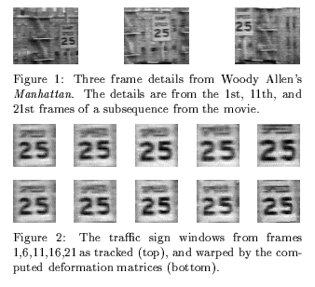
Tracking example
J. Shi and C. Tomasi. Good Features to Track. CVPR 1994.

Slide 49
Summary of KLT tracking
Find a good point to track (harris corner)
Use intensity second moment matrix and difference across frames to find displacement
Iterate and use coarse-to-fine search to deal with larger movements
When creating long tracks, check appearance of registered patch against appearance of initial patch to find points that have drifted

Slide 50
Implementation issues
Window size
Small window more sensitive to noise and may miss larger motions (without pyramid)
Large window more likely to cross an occlusion boundary (and it’s slower)
15x15 to 31x31 seems typical
Weighting the window
Common to apply weights so that center matters more (e.g., with Gaussian)

Slide 51
Why not just do local template matching?
Slow (need to check more locations)
Does not give subpixel alignment (or becomes much slower)
Even pixel alignment may not be good enough to prevent drift
May be useful as a step in tracking if there are large movements

Slide 52
The Lucas-Kanade Algorithm
https://youtu.be/D7r3-fHXvRU?t=1h40m54s

Slide 53
Two mins break

Slide 54
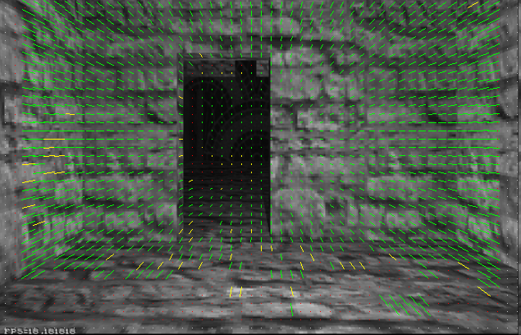
Optical flow
Vector field function of the spatio-temporal image brightness variations
Picture courtesy of Selim Temizer - Learning and Intelligent Systems (LIS) Group, MIT

Slide 55
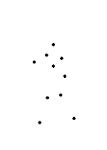
Motion and perceptual organization
Even “impoverished” motion data can evoke a strong percept
G. Johansson, “Visual Perception of Biological Motion and a Model For Its Analysis", Perception and Psychophysics 14, 201-211, 1973.

Slide 56
Motion and perceptual organization
Even “impoverished” motion data can evoke a strong percept
G. Johansson, “Visual Perception of Biological Motion and a Model For Its Analysis", Perception and Psychophysics 14, 201-211, 1973.

Slide 57
Uses of motion
Estimating 3D structure
Segmenting objects based on motion cues
Learning and tracking dynamical models
Recognizing events and activities
Improving video quality (motion stabilization)

Slide 58
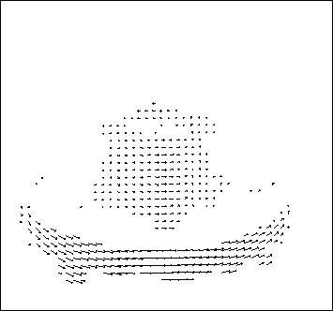
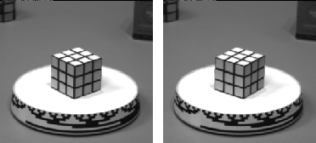
Motion field
The motion field is the projection of the 3D scene motion into the image
What would the motion field of a non-rotating ball moving towards the camera look like?

Slide 59
Optical flow
Definition: optical flow is the apparent motion of brightness patterns in the image
Ideally, optical flow would be the same as the motion field
Have to be careful: apparent motion can be caused by lighting changes without any actual motion
Think of a uniform rotating sphere under fixed lighting vs. a stationary sphere under moving illumination

Slide 60
Lucas-Kanade Optical Flow
Same as Lucas-Kanade feature tracking, but for each pixel
As we saw, works better for textured pixels
Operations can be done one frame at a time, rather than pixel by pixel
Efficient

Slide 61
Iterative Refinement
Iterative Lukas-Kanade Algorithm
Estimate displacement at each pixel by solving Lucas-Kanade equations
Warp I(t) towards I(t+1) using the estimated flow field
- Basically, just interpolation
Repeat until convergence
* From Khurram Hassan-Shafique CAP5415 Computer Vision 2003

Slide 62
Coarse-to-fine optical flow estimation
run iterative L-K
warp & upsample
run iterative L-K
.
.
.
image J
image I
image 1
image 2
Gaussian pyramid of image 1 (t)
Gaussian pyramid of image 2 (t+1)

Slide 63
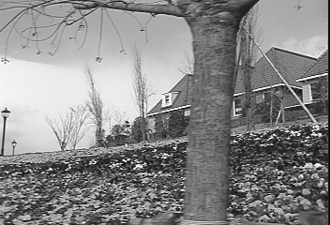
Example
* From Khurram Hassan-Shafique CAP5415 Computer Vision 2003

Slide 64
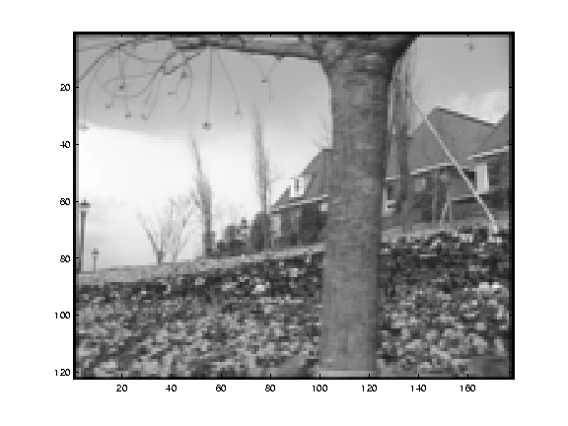
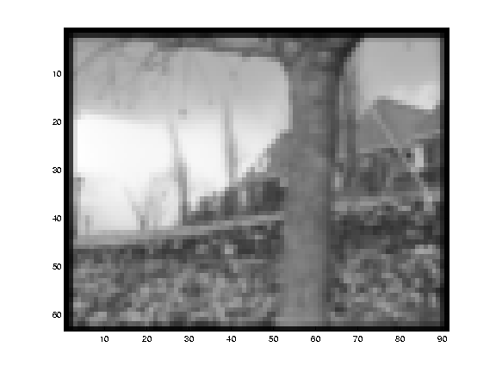
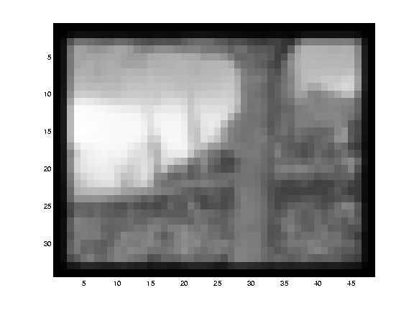
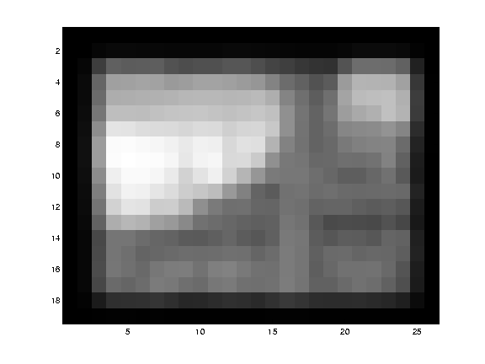
Multi-resolution registration
* From Khurram Hassan-Shafique CAP5415 Computer Vision 2003

Slide 65
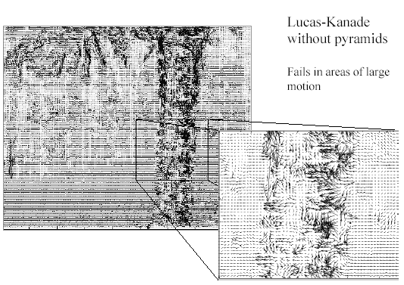
Optical Flow Results
* From Khurram Hassan-Shafique CAP5415 Computer Vision 2003

Slide 66

Optical Flow Results
* From Khurram Hassan-Shafique CAP5415 Computer Vision 2003

Slide 67
Errors in Lucas-Kanade
The motion is large
Possible Fix: Keypoint matching
A point does not move like its neighbors
Possible Fix: Region-based matching
Brightness constancy does not hold
Possible Fix: Gradient constancy
Notes:
Iterative refinement:
Estimate velocity at each pixel using one iteration of Lucas and Kanade estimation
Warp one image toward the other using the estimated flow field
Refine estimate by repeating the process

Slide 68


State-of-the-art optical flow
Start with something similar to Lucas-Kanade
+ gradient constancy
+ energy minimization with smoothing term
+ region matching
+ keypoint matching (long-range)
Region-based
+Pixel-based
+Keypoint-based
Large displacement optical flow, Brox et al., CVPR 2009

Slide 69
Things to remember
Major contributions from Lucas, Tomasi, Kanade
Tracking feature points
Optical flow
Stereo (later)
Structure from motion (later)
Key ideas
By assuming brightness constancy, truncated Taylor expansion leads to simple and fast patch matching across frames
Coarse-to-fine registration

Slide 70
Next week
HW 1 due Monday
Object/image alignment

